Slide 1
Collections and Arrays

Slide 2
General description
Interfaces and Collections class hierarchy
List Interface and its implementations
Set Interface and its implementations
Map Interface and its implementations
Queue Interface and its implementations
Arrays

Slide 3
General description
A collection represents a group of objects, known as elements. Some collections allow duplicate elements and others do not. Some are ordered and others. In the Java API Collection is the root.
There are few basic operations we’ll normally use with collections:
Add objects to the collection
Remove objects from the collection
Find out if an object (or group of objects) is in the collection
Retrieve an object from the collection
Iterate through the collection, looking at each element (object) one after another
The advantages of using collections:
Code reuse
Reduce programming effort
Increase the speed of elaborating, performance and quality of applications

Slide 4
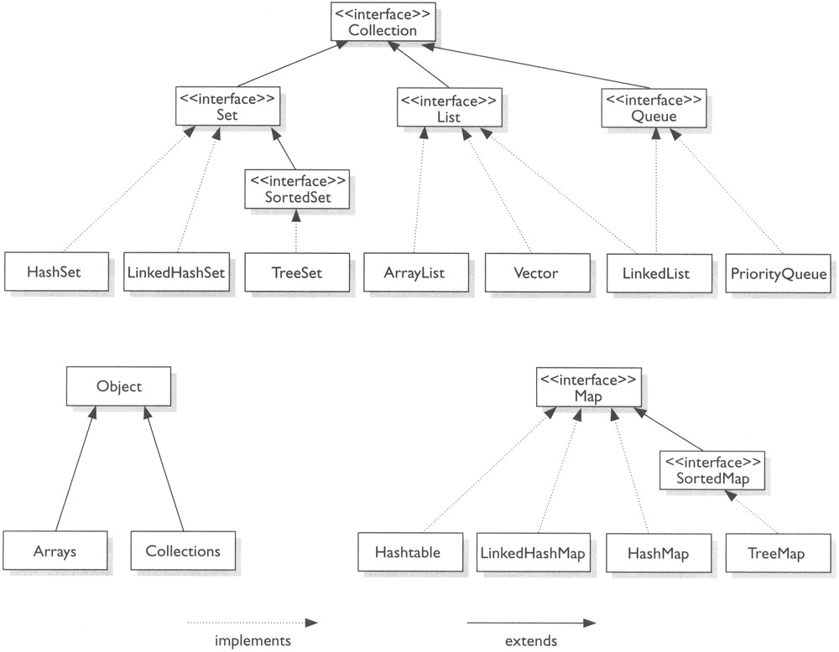
Interfaces and Collections class hierarchy

Slide 5
Interfaces and Collections class hierarchy
Depending on the necessity we’ll use:
Set - when we want a collection of unique elements
List – when we want elements inside the collection to be ordered
Tree – when we want elements inside the collection to be sorted
Map – when we want to keep in the data structure an object and an associated key
Queue – when we want elements inside the collection to be arranged in the order to be processed

Slide 6
List interface and its implementations
A List cares about the index. The one thing that List has that non-lists don’t have is a set of methods related to the index. Those key methods include things like get (int index), indexOf(Object o), add(int index, Object obj), and so on. List implementations are ordered by index position – a position that you determine either by setting an object at a specific index or by adding it without specifying position, in which case the object is added to the end.
List interface implementations:
ArrayList – we can think of this as a growable array. It gives us fast iteration and fast random access. We would choose this over a LinkedList when we need fast iteration but aren’t as likely to be doing a lot of insertion and deletion.
LinkedList – is ordered by index position, like ArrayList, except that the elements are doubly-linked to one another. This linkage gives us new methods (beyond what we get from the List interface) for adding and removing from the beginning or end, which makes it an easy choice for implementing a stack or a queue. LinkedList may iterate more slowly than an ArrayList, but it’s a good choice when we need fast insertion and deletion.
Vector – is basically the same as an ArrayList, but Vector methods are synchronized for thread safety. Normally we want to use ArrayList instead of Vector because the synchronized methods add a performance hit we might not need.

Slide 7
Set interface and its implementations
A Set cares about uniqueness – it doesn’t allow duplicates. Method equals() determines whether two objects are identical (in which case only one can be in the set).
Set interface implementations:
HashSet – is an unsorted and unordered Set. It uses hashcode of the object being inserted, so the more efficient hashCode() implementation is the better access performance is obtained. We would choose this class when we want a collection with no duplicates and we don’t care about order when we iterate through it.
LinkedHashSet – is an ordered version of HashSet that maintains doubly-linked List across all elements. We would choose this class instead of HashSet when we care about the iteration order. When we iterate through a HashSet the order is unpredictable, while a LinkedHashSet lets us iterate through the elements in the order in which they were inserted.
TreeSet – is one of two sorted collections (the other being TreeMap). It guarantees that the elements will be in ascending order, according to natural order. Optionally, we can construct a TreeSet with a constructor that lets us give the collection our own rules for what the order should be by using a Comparable or Comparator.

Slide 8
Map interface and its implementations
A Map cares about unique identifiers. We map a unique key to a specific value, where both the key and the value are, of course, objects. The Map implementations let us do things like search for a value based on the key, ask for a collection of just the values, or ask for a collection of just the keys. Like Sets, Maps rely on the equals() method to determine whether two keys are the same or different.
Map interface implementations:
HashMap – gives us an unsorted, unordered Map. When we need a Map and we don’t care about the order (when we iterate through it), then HashMap is the way to go. Where the keys land in the Map is based on the key’s hashcode, so, like HashSet, the more efficient our hashcode() implementation, the better access performance we’ll get. HashMap allows one null key and multiple null values in a collection.
Hashtable – is synchronized counterpart to HashMap, which means that its key methods are synchronized. Hashtable doesn’t let us have anything that’s null.
LinkedHashMap – maintains insertion order. Although it will be somewhat slower than HashMap for adding and removing elements, we can expect faster iteration with a LinkedHashMap.
TreeMap – is a sorted Map. TreeMap let us define a custom sort order (via a Comparable or Comparator) when we construct a TreeMap, that specifies how the elements should be compared to one another when they are being ordered.

Slide 9
Queue interface and its implementations
A Queue is designed to hold a list of “to-dos”, or things to be processed in some way. Although other orders are possible, queues are typically thought as FIFO (first-in, first-out). Queues support all of the standard Collection methods and they also add methods to add and subtract elements and review elements.
Queue interface implementations:
PriorityQueue – its purpose is to create a “priority-in, priority-out” queue as opposed to a typical FIFO queue. A PriorityQueue’s elements are ordered either by natural ordering (in which case the elements that are sorted first will be accessed first) or according to a Comparator. In either case, the elements’ ordering represents their relative priority.
LinkedList – base implementation of Queue interface.

Slide 10
Arrays
In Java, arrays are objects created dynamically and can be assigned to variables of type Object
Arrays can hold primitives or objects
It is never legal to include the size of an array in the declaration
We must include the size of an array when we construct it (using new)
Elements in an array of objects are not automatically created, although primitive array elements are given default values
All elements inside an array are of the same type
If an array has n elements, we say that n is the array’s length (which can be obtained by attribute length) and the elements can be accessed using indices from 0 to n-1
An example can be found here: http://docs.oracle.com/javase/tutorial/java/nutsandbolts/arrays.html

Slide 11



Radu Baroncea
Developer
radu.baroncea@endava.com
069479862
radubaroncea

